Slide 1
Application of NLP and ML to Legislative Text
COMP 4447 - Ben Hersh

Slide 2
What was I trying to solve?
I’ve had a long term interest in how AI/ML could be applied to legislative text (but have never pursued it)
Long term, I would like to explore how AI can be used to predict likely behavioral impacts of legislation

Slide 3
What was I trying to solve?
Could we predict Multi-millionaires making use of IRAs to get tax deferrals
Could we predict negative outcomes from social legislation

Slide 4
In order to learn more about legislative text, let’s pursue something simpler.
Can we predict party sponsorship from just the text of a piece of legislation?

Slide 5
Tools Used
Python both in .py and .ipynb
Pandas and Numpy
API from legiscan to find and download legislative bills
Pytorch for ML code
T-SNE for visualizing clustering
BERT

Slide 6
What is BERT?
Natural Language Processing Model proposed by researchers at Google Research in 2018
General Language Understanding Evaluation
Is an Encoder Model
Ref: https://www.geeksforgeeks.org/explanation-of-bert-model-nlp/

Slide 7
Approach : Data Acquisition
Focus on NH State Legislature (being where I live)
Start with small data set (2 years)
Use Legiscan.org to search for and download details of legislative text

Slide 8
Data Types
Bill Details
Title
Year and Session
Sponsors
Status
Amendments
Committee
Full Text hyperlinks
Party Affiliation of Members

Slide 9
Data Preparation
Extract title
Extract Sponsors
Download full text (html from NH Legislative site)
Identify if all sponsors are from one party or not. Use this the label
Democrat, Republican, Both

Slide 10
Data Preparation
Using BeautifulSoup extract bill text from html
Combine all into individual dataframe and save

Slide 11
Tokenization
I did not want to present raw text to the ML Model
Decided to use the BERT model to encode the text.
This was in hope that the encoded output would capture semantic and contextual relationships

Slide 12
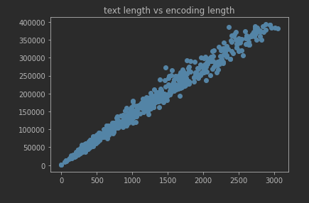
Challenge with the BERT model
The length of the output encoding depends on the length of the input text

Slide 13
Why is this a challenge?
ML models like constant-length inputs
How to get Constant Length Inputs
Linear Resampling
Interpolate the larger encoding to a smaller size
MaxPool1D
Find maximum values in small windows and output a smaller encoding

Slide 14
The Model
I chose a simple sequential neural network
2048 input
Sigmoid/Relu
2048 -> 1024
Sigmoid/Relu
1024 -> 128
Sigmoid/Relu
128 -> 4
Softmax

Slide 15
Results
Not-encouraging
Models either overfit or underfit
Did not generalize well on mapping the encoded text to the party sponsorship label

Slide 16
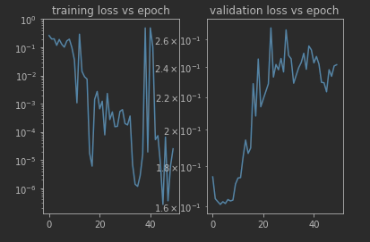
This came to typical of the training runs I tried after adjusting some training parameters like learning rate

Slide 17
Further Data Exploration
How does my decreased size data relate to each other
Cosine-Similarity
How different are my encoding vectors
Sklearn has a pair-wise cosine-similiarity function
0 - orthogonal, 1 - the same

Slide 18
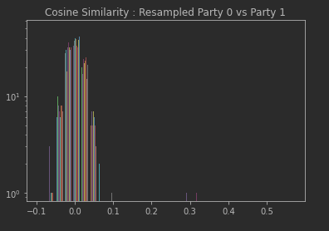
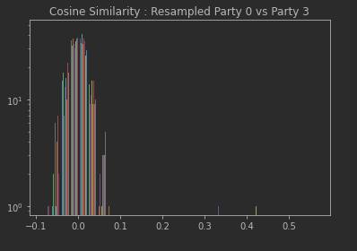
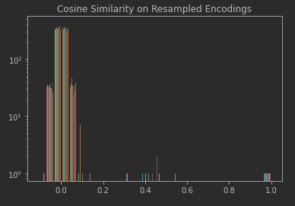
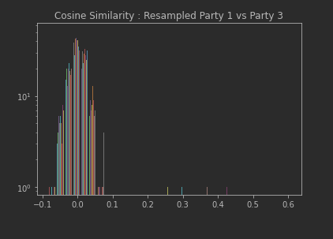
Across All Labels
This looks good, most of the encoding vectors
Are dissimilar
1D Resample
By Label Pairs
While the vectors are dissimilar, there is no clear dissimilarity across the labels

Slide 19
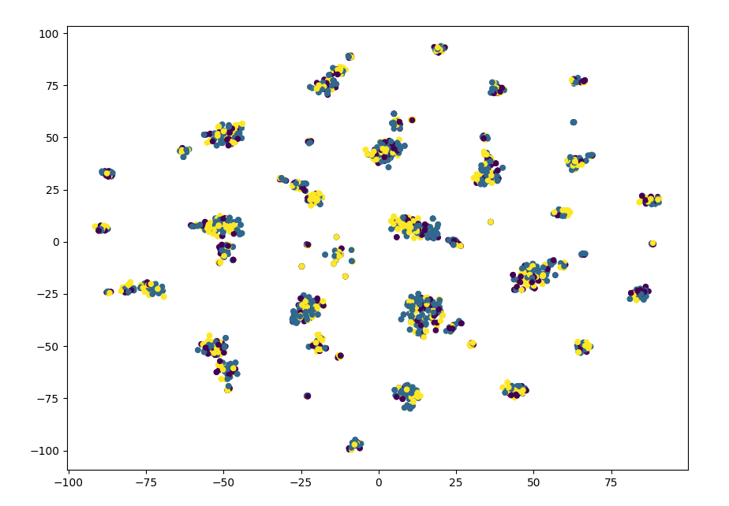
Another Visualization : T-Sne
T-Sne calculates the probability the two inputs are close to each other.
Also collapses the dimensional space to 2 (or 3) dimensions of visualization
This is another way to see that my labels all fall within the same clusters.

Slide 20
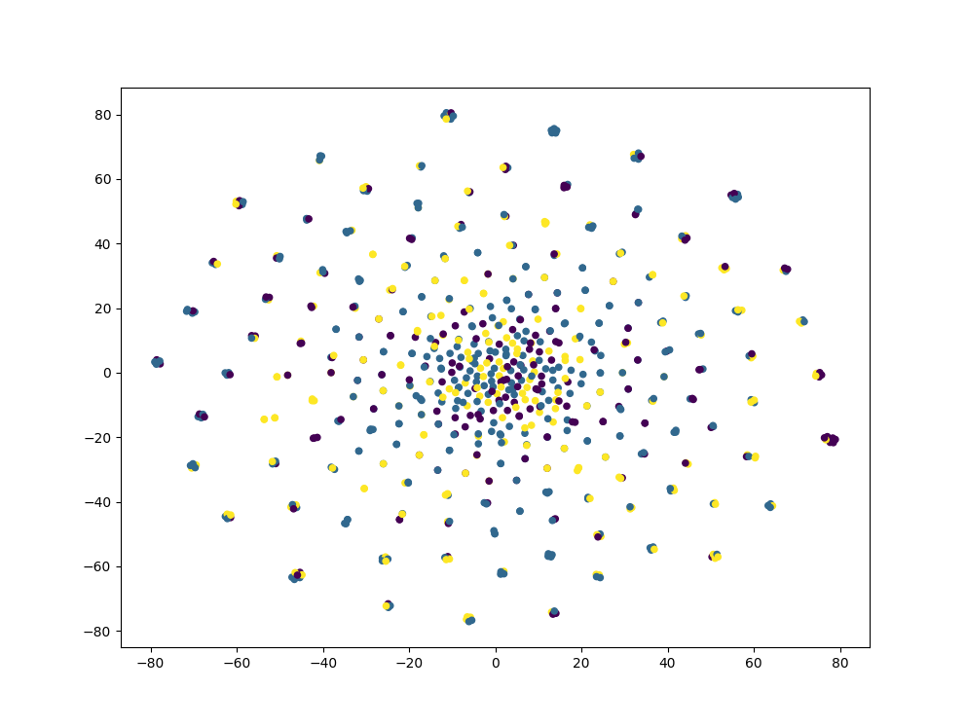
One Last Question to Explore
Was I losing too much information by going down to a 2048 element vector?
Went up to 8192 element vectors and applied t-sne.

Slide 21
Conclusions
Their the choice of encoding is hampering the model or
There is no real difference between the wording of bills by both parties (which seems suspect from a common-sense point of view)

Slide 22
Questions?

